Slide 1
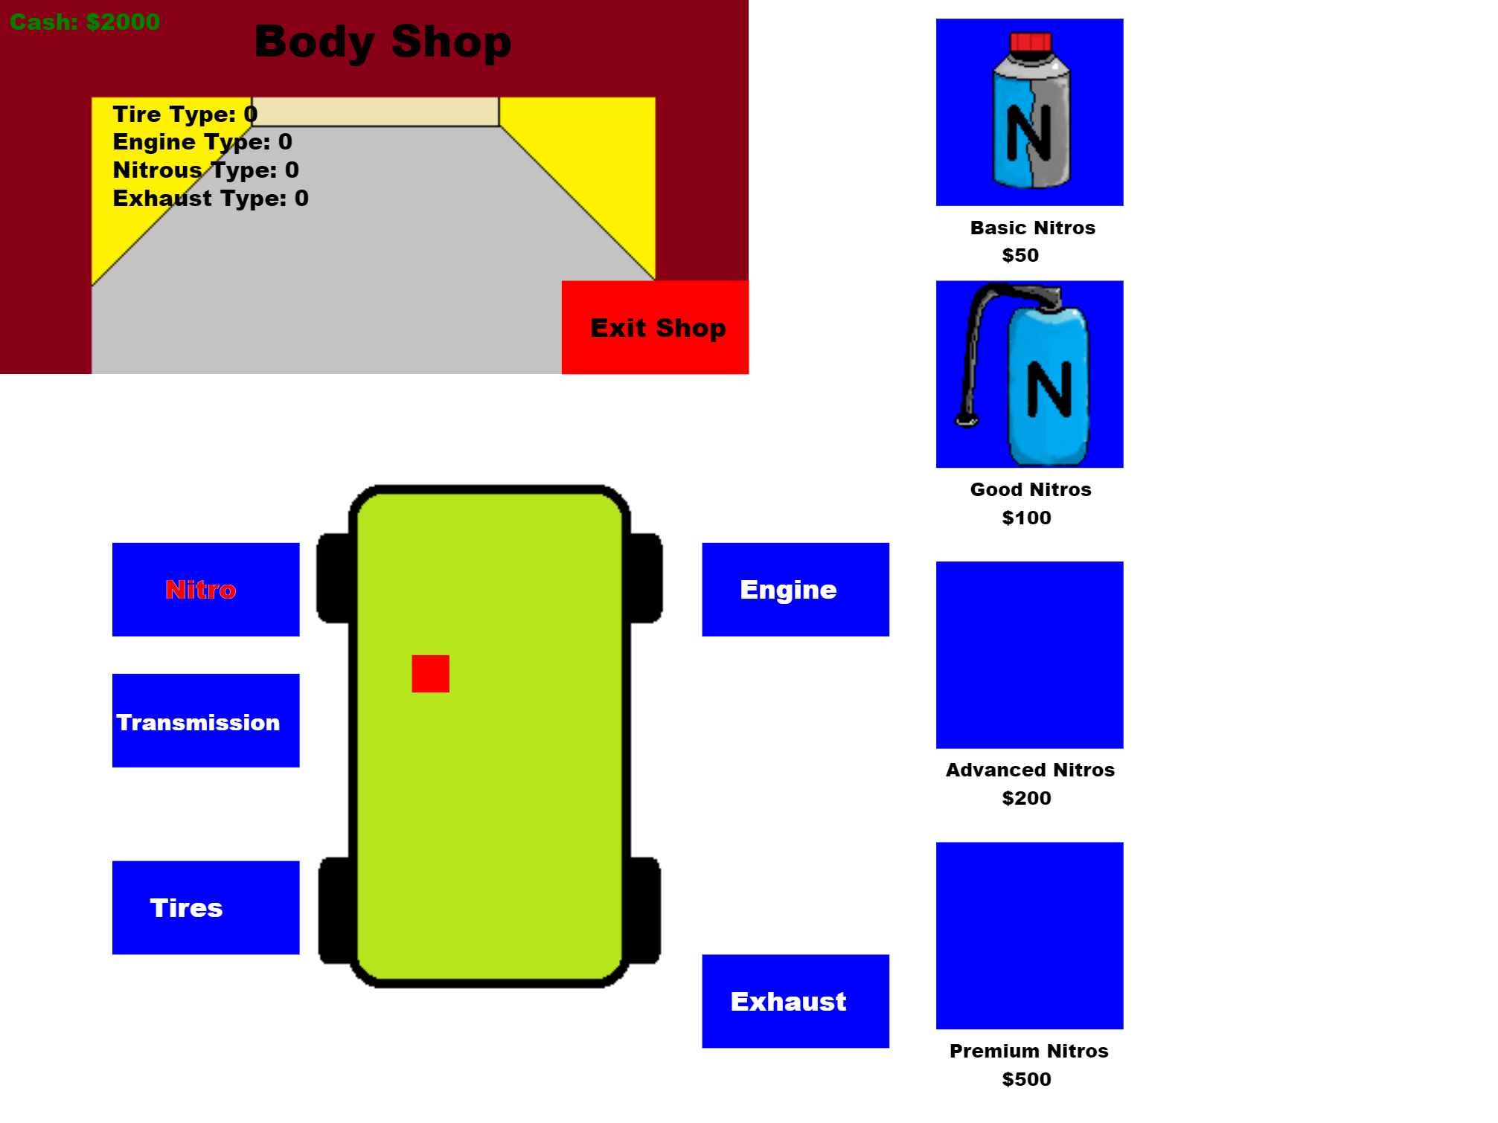
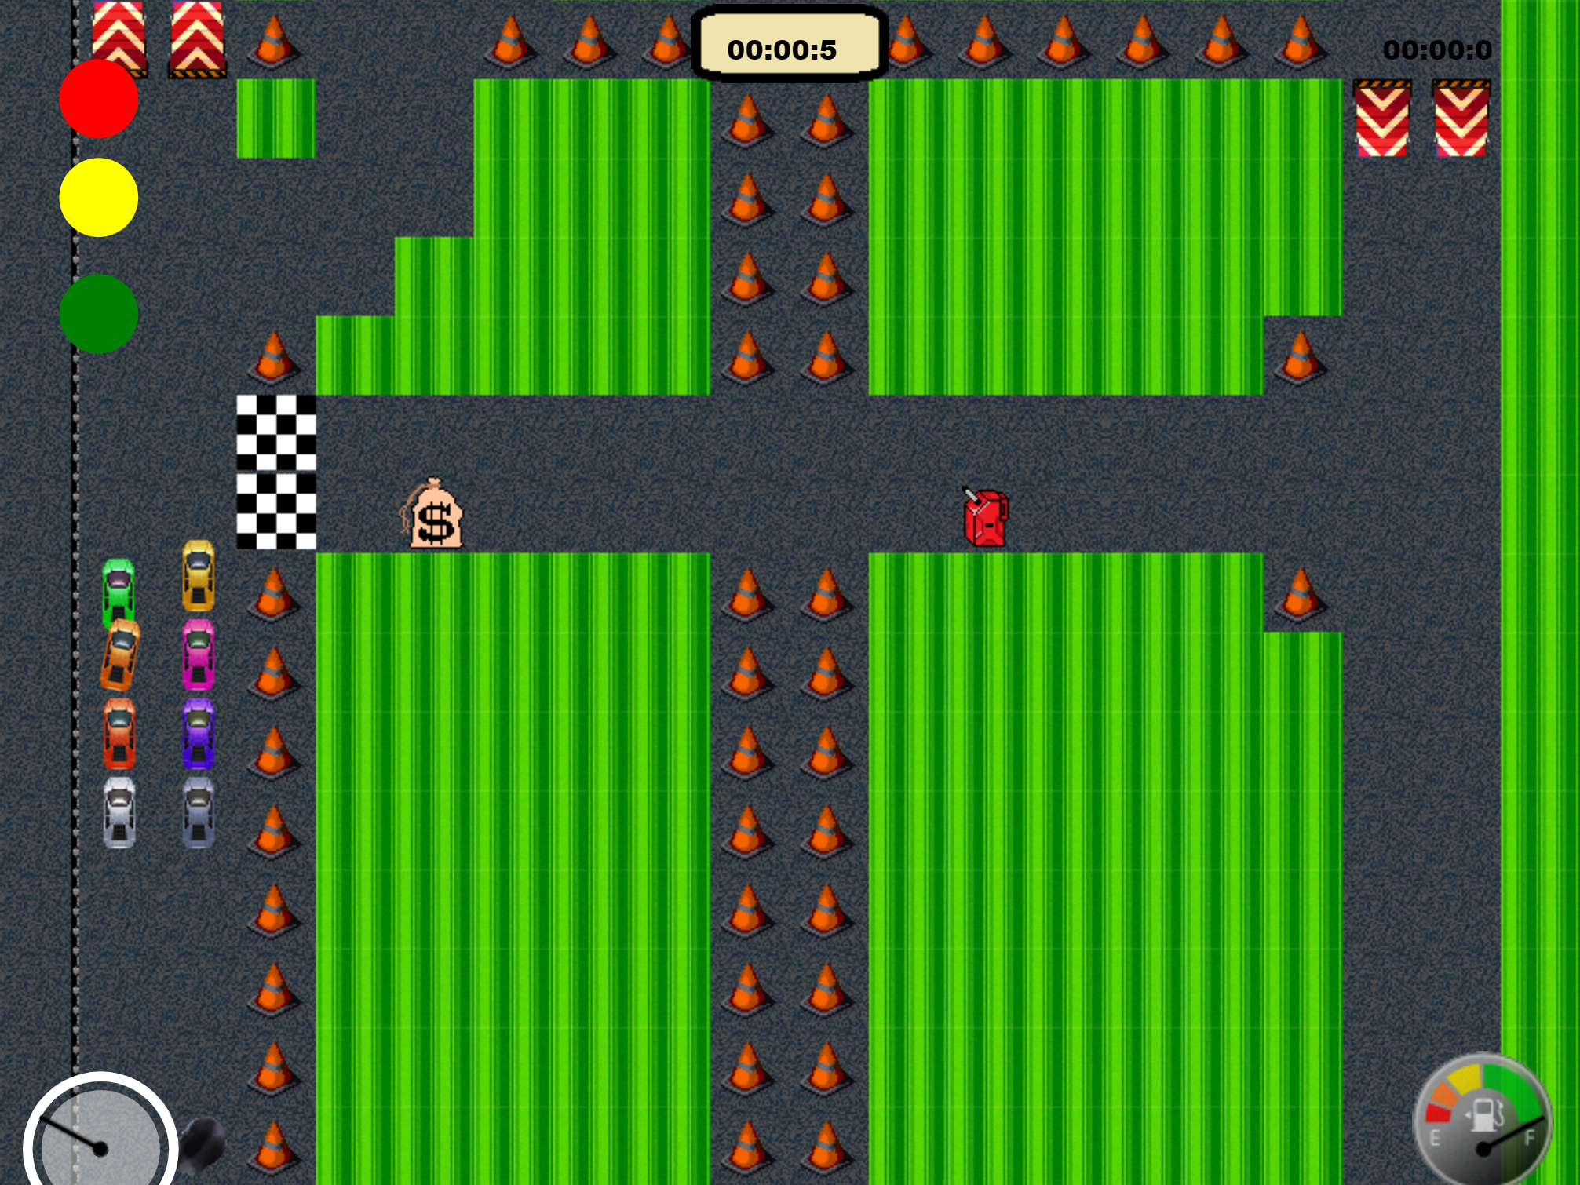
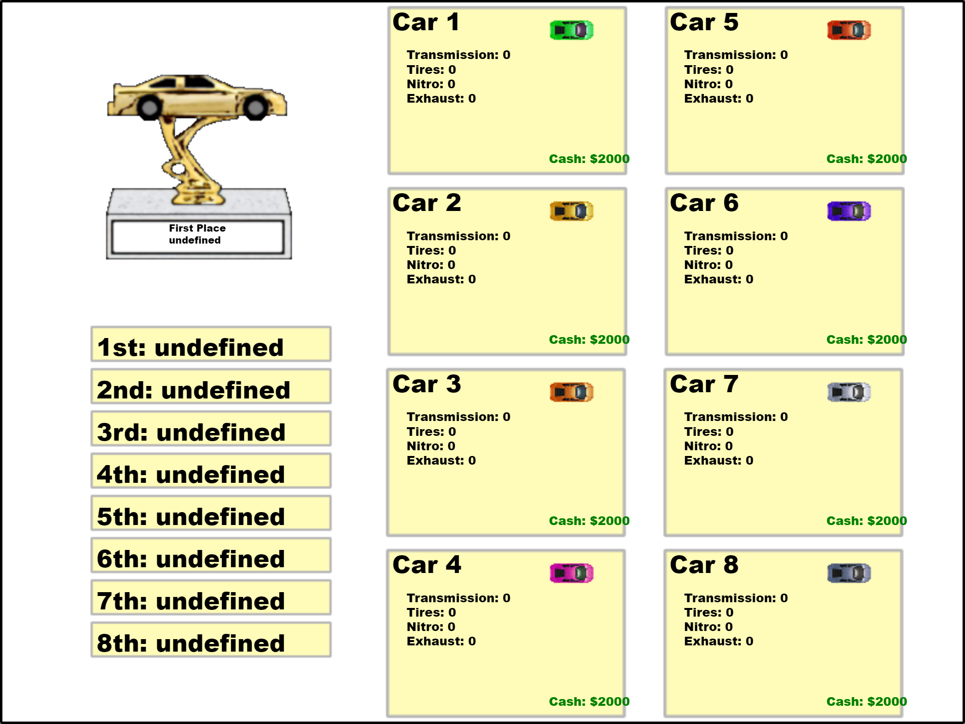
Little Racers
Pitch Date: June 22 , 2019 Week 2: 7/7/2019
Release Date: September 15, 2019 10 weeks to go!
Team Lead: Vince McKeown
13 contributors (+5)

Slide 2
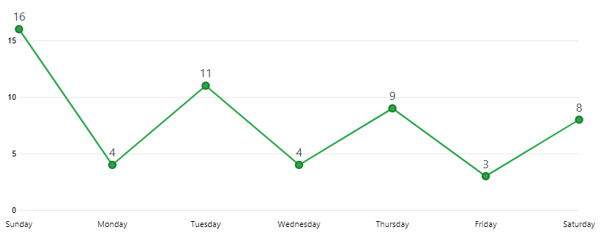
Updates to Code
116 Commits
Mike LeSauvage
Refactored movement code (including airborne and angle calculations, and collisions)
Aligned Race Time and adjusted sounds and indicators
Vince McKeown
Updates to Level Editor
Initial Race Results Screen
Body Shop buttons
Connected Sounds
Simon
Added Mute Key

Slide 3
Updates to Code
116 Commits
Anthony Free
Added Fuel Gauge
Terrence McDonnell
Constrained Car Angles between 0 and – 2 Pi
Corrected Car Airborne collisions
H Trayford
Corrected Center Player at Start
Cleared Track marks between levels
Added Tiled for Level Editing
Randy Tan Shaoxian
Added Speedometer

Slide 4
Updates to Code
116 Commits
Jeff Hanlon
Allowed cars to jump over Grass

Slide 5
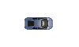

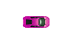
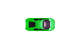



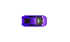


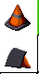

Updates to Art
Jeff Hanlon
Anthony Free
Gonzalo Delgado

Slide 6
Updates to Sound
Jeff Hanlon
VO Announce Sounds
Ready, Set, Go
Start Your Engines
And the Winner Is
Attention Drivers
Final Lap
Car Numbers 1 through 8
Holy Cow
Nice Moves
Race Completed
Watch out
Whoa!
Alan Z
Background Music

Slide 7
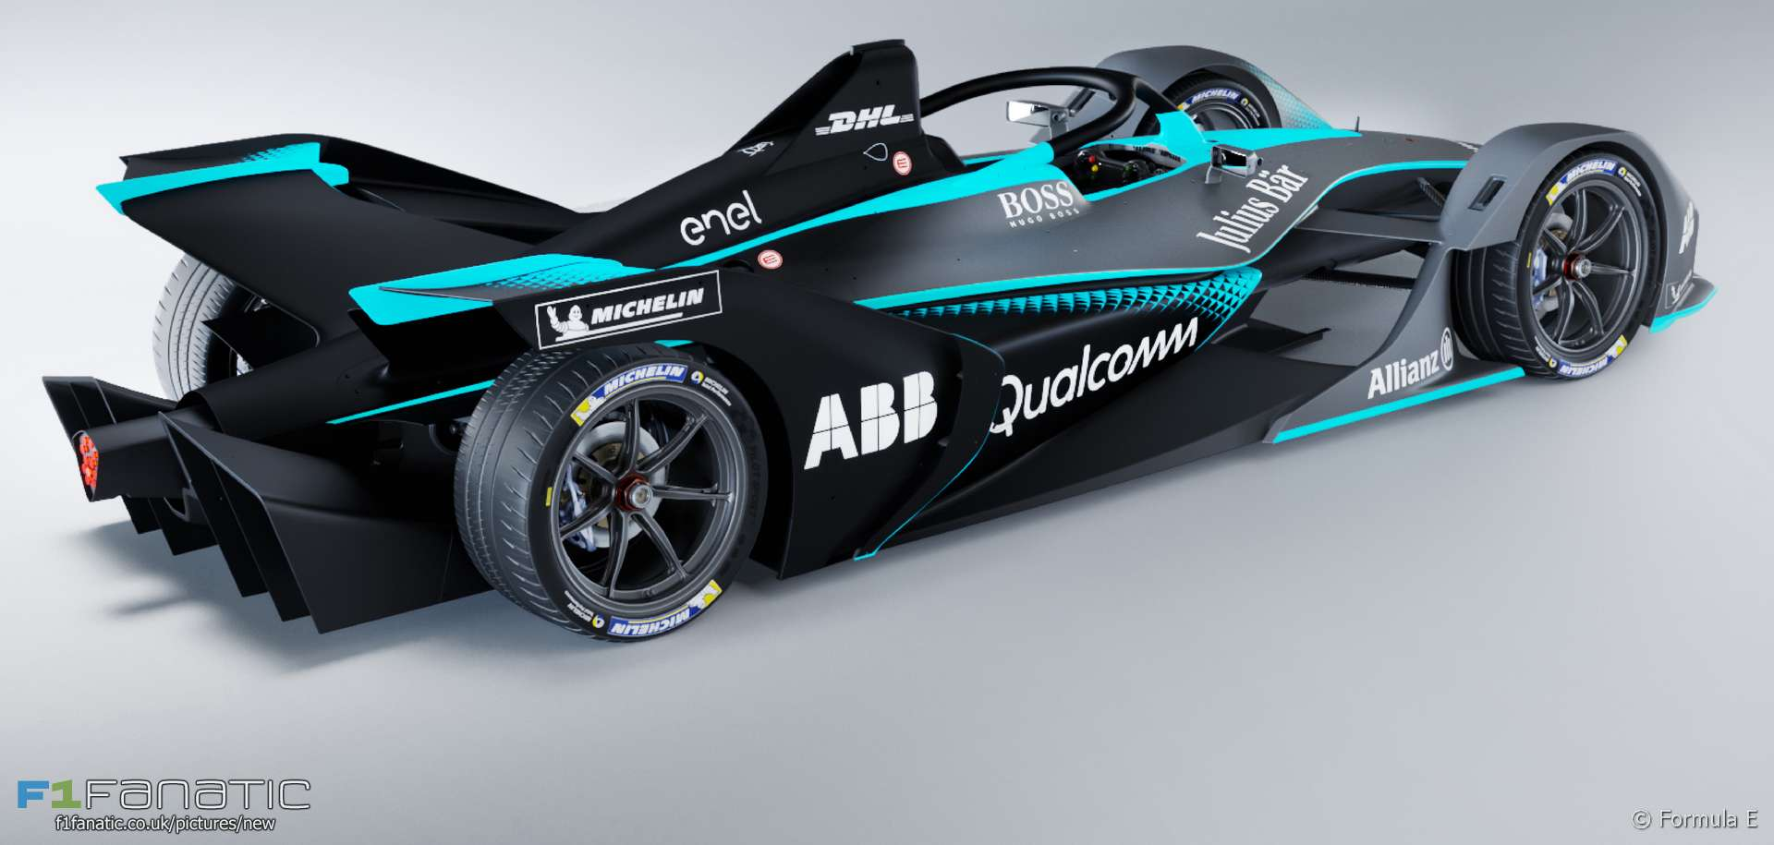
Demo
Cutover to Game

Slide 8
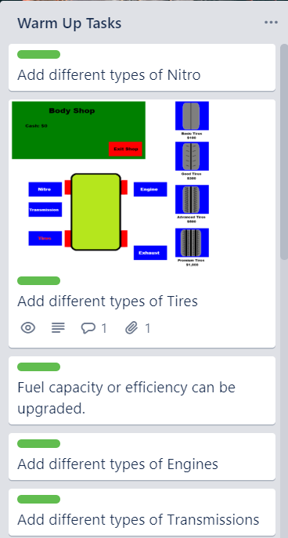
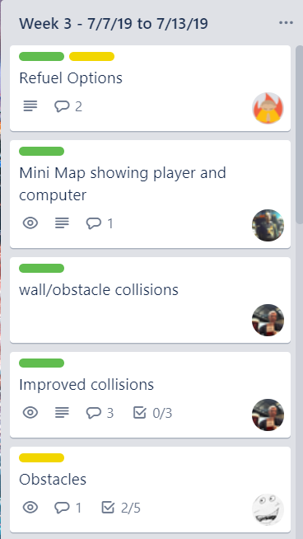
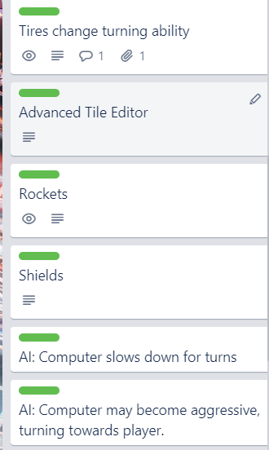
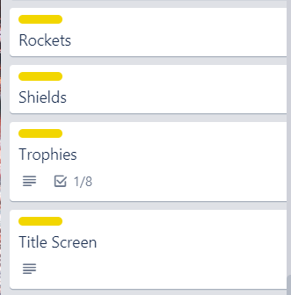
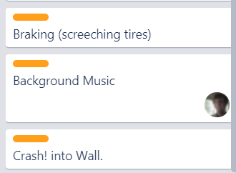
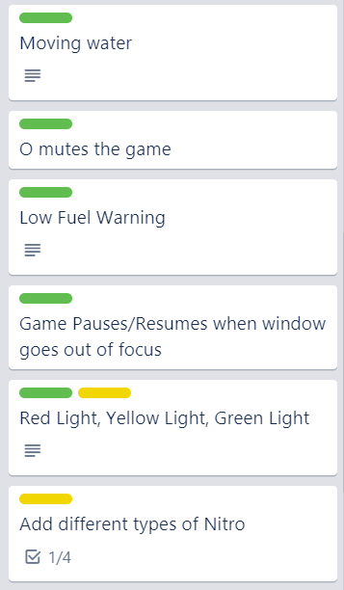
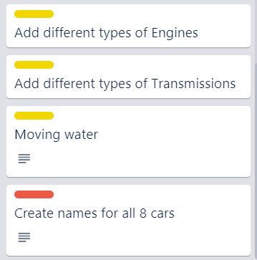
Week 3 Schedule
Committed
Code
Artwork
Sound

